Slide 1

图像和视频中的颜色Color in Image and Video
授课教师：张小燕
邮箱：xyzhang15@szu.edu.cn

Slide 2
Outline of Lecture 03
Color Science
Light and Spectra
Human Vision
Image Formation
Color-Matching Functions
CIE Chromaticity Diagram
Out-of-Gamut Colors
Color Coordinate Schemes
Color Models in Image
Color Models in Video
Demo

Slide 3

Color Science
What is color？

Slide 4
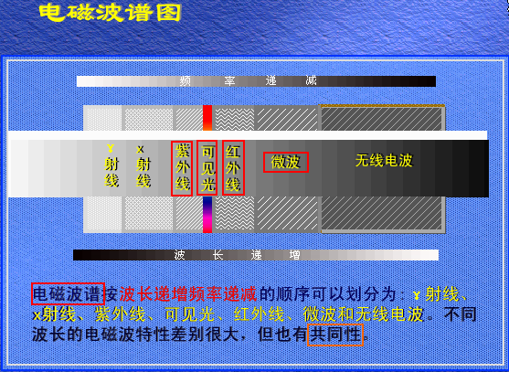
Color Science
Light and Spectra
Light is an electromagnetic wave (电磁波).
紫外光
红外光
400nm
700nm
780nm
546.1nm
435.8nm

Slide 5
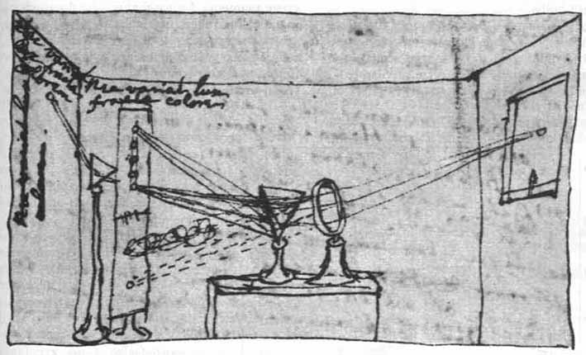
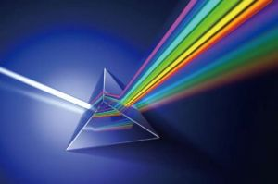
Color Science
Light and Spectra
Spectrophotometer (分光光度计): a device used to measure visible light by reflecting light from a diffraction grating (a ruled surface) that spreads out the different wavelengths.
Visible light is an electromagnetic wave （电磁波）in the range 400 nm to 700 nm (where nm stands for nanometer, 10⁻⁹ meters).
Sir Isaac Newton’s experiments.

Slide 6
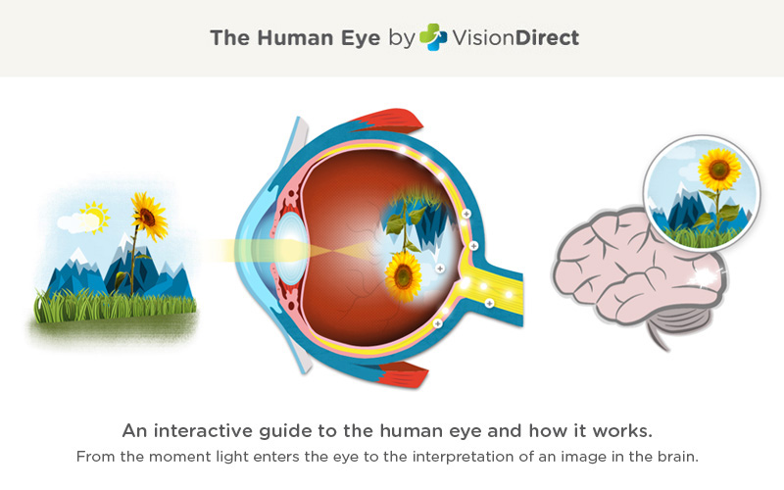
Color Science
Human Vision
The retina（视网膜）consists of an array of rods (柱状细胞) and three kinds of cones (视锥细胞).
The rods come into play when light levels are low and produce an image in shades of gray (“all cats are gray at night!”).
For higher light levels, the cones each produce a signal. Because of their differing pigments (色素), the three kinds of cones are most sensitive to red (R), green (G), and blue (B) light.

Slide 7
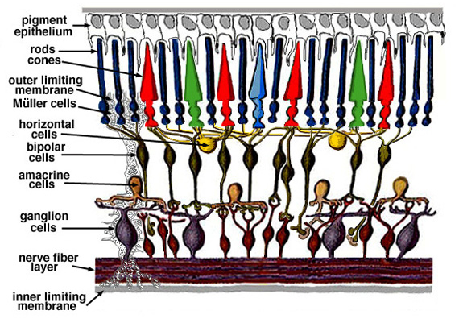
Color Science
Human Vision
Light

Slide 8
Color Science
Human Vision
Spectral Power Distribution (SPD,光谱能量分布) or a spectrum, shows the relative power in each wavelength interval
The symbol for wavelength is λ. This curve is called E(λ).
Spectral power distribution
400 450 500 550 600 650 700
Wavelength (nm)

Slide 9
Color Science
Human Vision
Spectral Sensitivity of the Eye(眼睛的光谱灵敏度)
R, G, and B cones, and Luminous Efficiency curve V(λ).
光的颜色由光的波长决定，短波产生蓝色感觉，长波产生红色感觉
1.0
V
0.8
Relative response
0.6
0.4
G
R
0.2
B
0.0
400
450
500 550
600
650
700
Wavelength (nm)

Slide 10
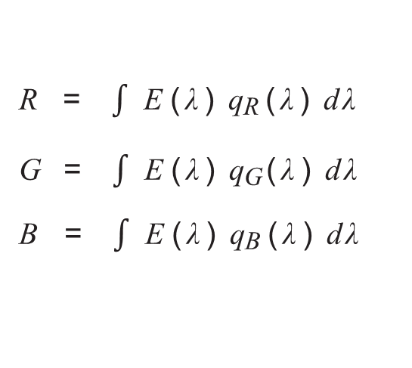
Color Science
Human Vision
These spectral sensitivity functions are usually denoted by a vector function q(λ), with components
The response in each color channel in the eye is proportional to the number of neurons firing.
We can succinctly write down this idea in the form of an integral:
q (λ) =
(q_{R}(λ), q_{G}(λ), q_{B}(λ))^{T}
R = $\int{\text{E}\text{(}\text{λ}\text{)} \text{q}\text{R}\text{(}\text{λ}\text{)} \text{d}\text{λ} }$
G = $\int{\text{E}\text{(}\text{λ}\text{)} \text{q}\text{G}\text{(}\text{λ}\text{)} \text{d}\text{λ} }$
B = $\int{\text{E}\text{(}\text{λ}\text{)} \text{q}\text{B}\text{(}\text{λ}\text{)} \text{d}\text{λ}}$

Slide 11
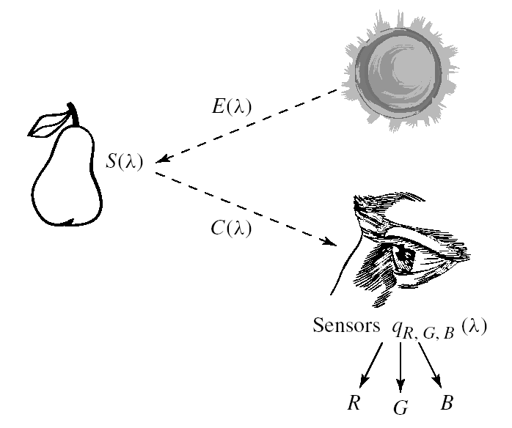
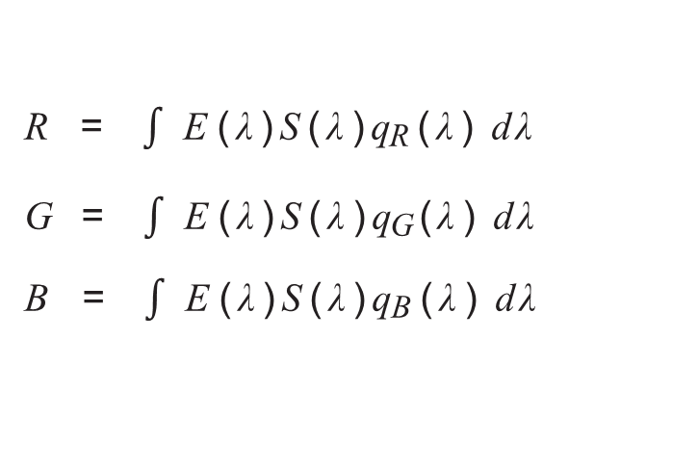
Color Science
Image Formation
The equations that take into account the image formation model are:
R = $\int{\text{E}\text{(}\text{λ}\text{)}\text{S}\text{(}\text{λ}\text{)}\text{q}\text{R}\text{(}\text{λ}\text{)} \text{d}\text{λ} }$
G = $\int{\text{E}\text{(}\text{λ}\text{)}\text{S}\text{(}\text{λ}\text{)}\text{q}\text{G}\text{(}\text{λ}\text{)} \text{d}\text{λ} }$
B = $\int{\text{E}\text{(}\text{λ}\text{)}\text{S}\text{(}\text{λ}\text{)}\text{q}\text{B}\text{(}\text{λ}\text{)} \text{d}\text{λ}}$

Slide 12

Color Science
Color-Matching Functions
Red
Room illumination
Green
Blue
Black partition
White screen
Eye

Slide 13
Color Science
Color-Matching Functions
The particular set of three basic lights used in an experiment are called the set of color primaries.
To match a given color, a subject is asked to separately adjust the brightness of the three primaries using a set of controls until the resulting spot of light most closely matches the desired color.
A device for carrying out such an experiment is called a colorimeter(色度计).

Slide 14
Color Science
Color-Matching Functions
The amounts of R, G, and B the subject selects to match each single-wavelength light forms the color-matching curves. These are denoted r¯(λ), ¯g(λ), ¯b(λ)
CIE(国际照明委员会) RGB color-matching functions.
r¯ (λ)
b¯ (λ)
Relative sensitivity
g¯ (λ)
0
400 450 500 550 600 650 700
Wavelength (nm)

Slide 15
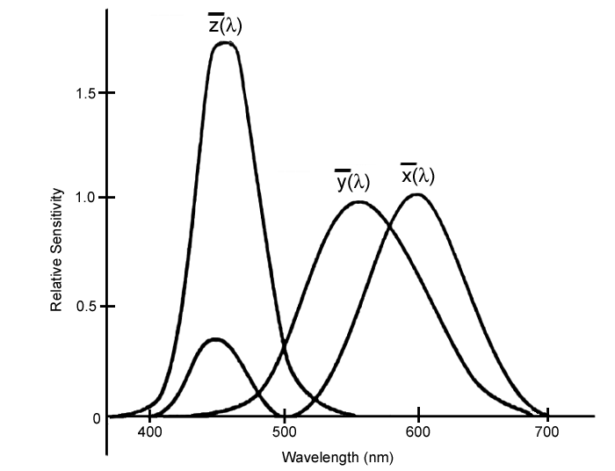
Color Science
CIE Chromaticity Diagram
Since the r¯(λ) color-matching curve has a negative lobe, a set of fictitious primaries were devised that lead to color-matching functions with only positives values.
They are a 3 × 3 matrix away from r¯, ¯g, ¯b curves, and are denoted x¯(λ), y¯(λ), z¯(λ).
CIE standard XYZ color-matching functions x¯(λ), y¯(λ), z¯(λ).

Slide 16
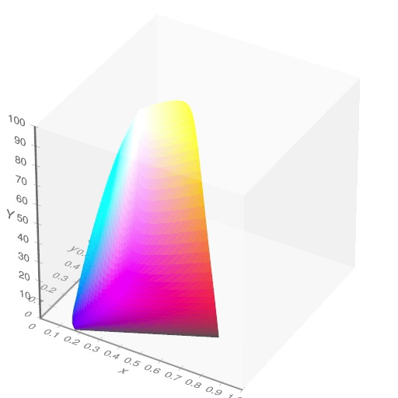
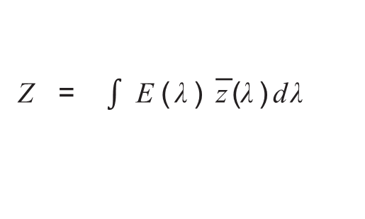
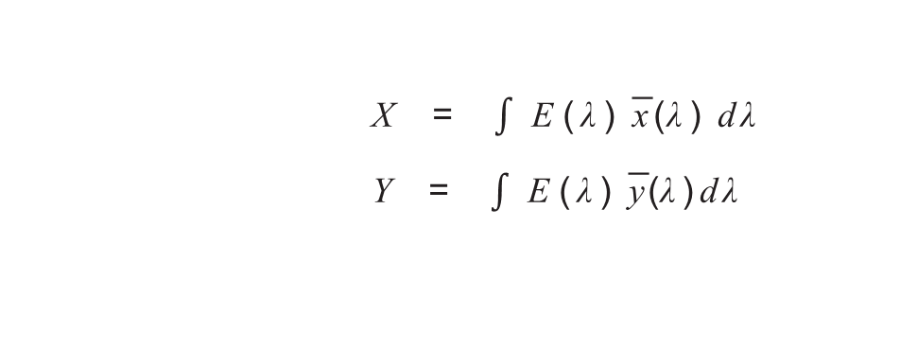
Color Science
CIE Chromaticity Diagram(色度图)
A color is the set of tristimulus values X, Y , Z defined
X = $\int{\text{E}\text{(}\text{λ}\text{)} \text{x}\text{¯}\text{(}\text{λ}\text{)} \text{d}\text{λ} }$
Y = $\int{\text{E}\text{(}\text{λ}\text{)} \text{y}\text{¯}\text{(}\text{λ}\text{)}\text{d}\text{λ} }$
Z = $\int{\text{E}\text{(}\text{λ}\text{)} \text{z}\text{¯}\text{(}\text{λ}\text{)}\text{d}\text{λ} }$

Slide 17
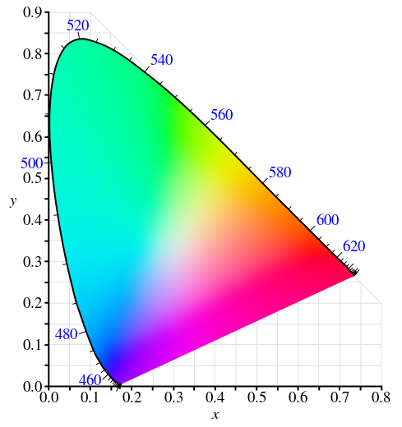
Color Science
CIE Chromaticity Diagram
CIE chromaticity diagram
CIE devised a 2D diagram based on the values of (X, Y, Z) triples.
White point
Color monitors are specified in part by the white point chromaticity

Slide 18
Color Science
Out-of-Gamut Colors
Gamut(色彩空间，色域)：refers to the subset of colors which can be accurately represented in a given circumstance, such as within a given color space or by a certain output device.
The out-of-gamut (超色域）color shown by a triangle is approximated by the intersection of (a) the line from that color to the white point with (b) the boundary of the device color gamut.

Slide 19
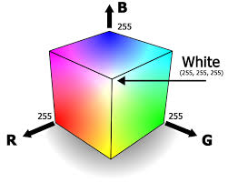
Color Science
Color Coordinate Schemes
RGB：an additive color model（加性颜色模型），in which red, green, and blue light are added together in various ways to reproduce a broad array of colors.
RGB color model is used for the sensing, representation, and display of images in electronic systems, such as televisions and computers.
XYZ to RGB Transform

Slide 20
Color Science
Color Coordinate Schemes
HSL — Hue（色调）, Saturation （饱和度）and Lightness;
HSV — Hue, Saturation and Value;
They are more closely align with the way human vision perceives color-making attributes

Slide 21
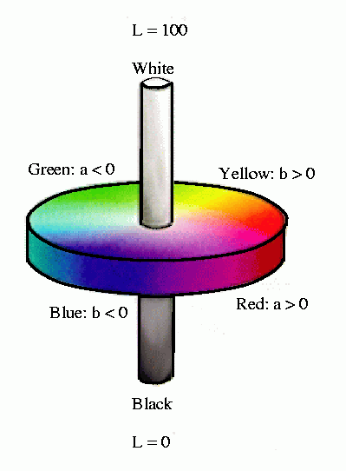
Color Science
L*a*b*(CIELAB) Color Model
L* for the lightness from black (0) to white (100), a* from green (−) to red (+), and b* from blue (−) to yellow (+).

Slide 22
Color Science
L*a*b*(CIELAB) Color Model
CIELAB was designed so that the same amount of numerical change in these values corresponds to roughly the same amount of visually perceived change (Weber’s Law（韦伯定理）).
(a) Hue ramp and L channel of HSL space, (b) Hue ramp and L channel of CIELAB space.

Slide 23
Outline of Lecture 03
Color Science
Light and Spectra
Human Vision
Image Formation
Color-Matching Functions
CIE Chromaticity Diagram
Out-of-Gamut Colors
Color Coordinate Schemes
Color Models in Image
Color Models in Video
Demo

Slide 24
Color Models in Image
RGB Color Model
Usually used for storing color information
Used for the sensing, representation, and display of images in electronic systems.
RGB is a device-dependent color model: different devices detect or reproduce a given RGB value differently.

Slide 25
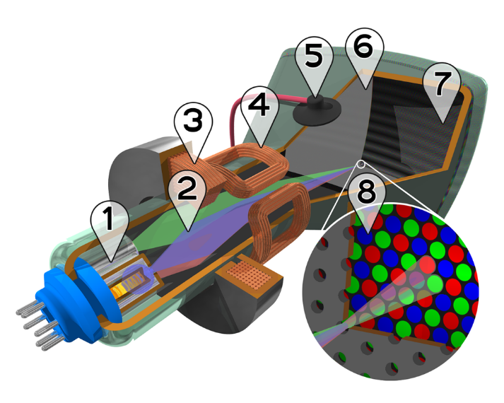

Color Models in Image
Gamma Correction (伽玛校正)
The RGB numbers in an image file are converted back to analog, and drive the electron guns in the cathode ray tube (CRT, 阴极射线管).
The light emitted is actually roughly proportional to the voltage raised to a power; this power is called “gamma,” γ.
In order to make images look right, make a gamma correction.
1. Three electron emitters 2. Electron beams 3. Focusing coils 4. Deflection coils 5. Connection for final anodes 6. Mask for separating beams 7. Phosphor layer 8. Close-up of the phosphor-coated inner side of the screen

Slide 26
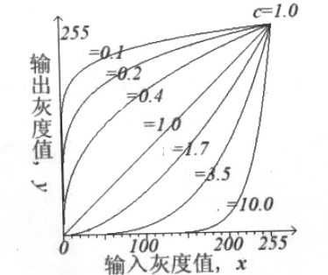
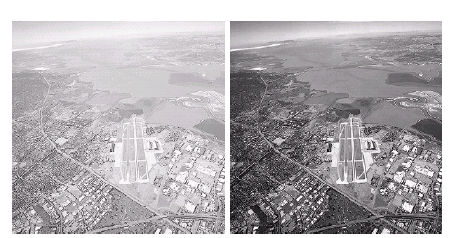









Color Models in Image
Gamma Correction (伽玛校正)
Gamma correction also is used for image processing.
$$y=cx^{γ}$$
$$γ$$
$$γ$$
$$γ$$
$$γ$$
$$γ$$
$$γ$$
$$γ$$
原始图
$$γ=3$$

Slide 27
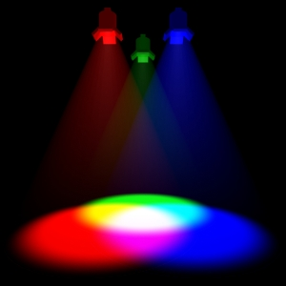
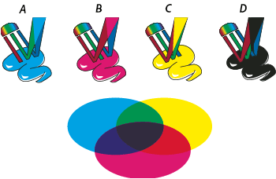
Color Models in Image
Subtractive Color: CMY Color Model
Additive color. When two light beams impinge on a target, their colors add; when two phosphors on a CRT screen are turned on, their colors add.
But for ink deposited on paper, the opposite situation holds: yellow ink subtracts blue from white illumination, but reflects red and green; it appears yellow.

Slide 28

Color Models in Image
Subtractive Color: CMY Color Model
These subtractive color primaries are Cyan (C), Magenta (M ) and Yellow (Y ) inks.
Blue Cyan Yellow Red
Magenta
Green
Green
Magenta
Red
Yellow
Cyan
Blue
Black (0, 0, 0)
White (1, 1, 1)
White (0, 0, 0)
Black (1, 1, 1)

Slide 29
Color Models in Image
Subtractive Color: CMY Color Model
Transformation from RGB to CMY
Truly “black” black ink is in fact cheaper than mixing colored inks to make black. Therefore, we use CMYK system in real color printer (K represents black).

Slide 30
Color Models in Image
Subtractive Color: CMY Color Model
思考题
彩色喷墨打印机使用CMY模型，当青色墨水喷洒在一片白纸上时， 在蓝色光线下他看起来像什么颜色？
（蓝色）
在白色光线下他看起来像什么颜色？
（青色）

Slide 31
Outline of Lecture 03
Color Science
Light and Spectra
Human Vision
Image Formation
Color-Matching Functions
CIE Chromaticity Diagram
Out-of-Gamut Colors
Color Coordinate Schemes
Color Models in Image
Color Models in Video
Demo

Slide 32
Color Models in Video
Methods of dealing with color in digital video largely derive from older analog methods of coding color for TV.
In Europe, video tape uses the PAL or SECAM codings, which are based on TV that uses a matrix transform called YUV.
YIQ is used to transmit TV signals in North America and Japan.
Another video color model YCbCr is closely related to YUV.

Slide 33
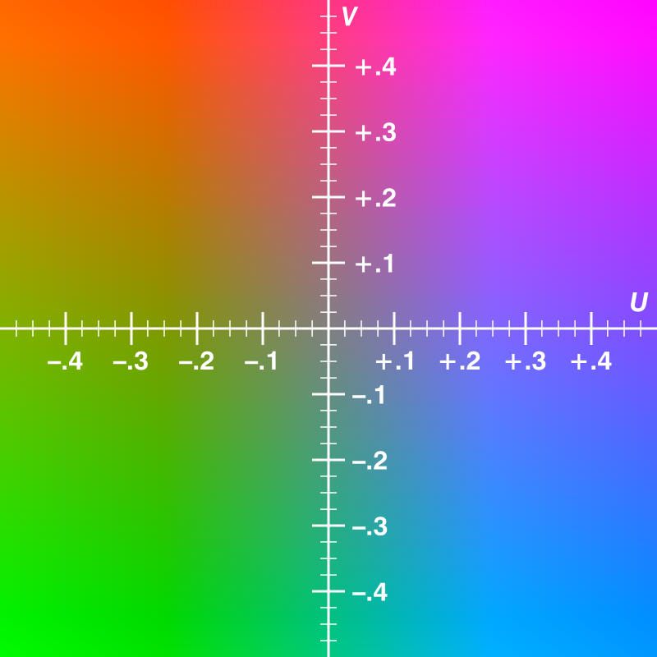
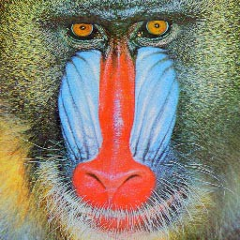
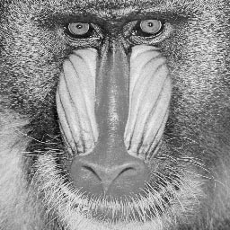
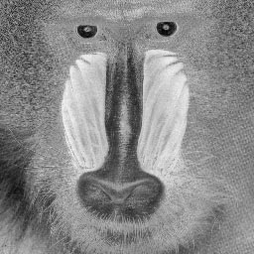
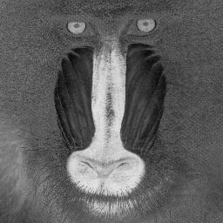

Color Models in Video
YUV Color Model
Y is luminance ( Y’is “Luma”, gamma corrected signal of Y )
Chrominance U, V refers to the difference between a color and a reference white at the same luminance.
$\left[\begin{matrix}Y \\ U \\ V\end{matrix}\right]$=T $\left[\begin{matrix}R \\ G \\ B\end{matrix}\right]$, T is the transformation matrix.
Y
U
V

Slide 34
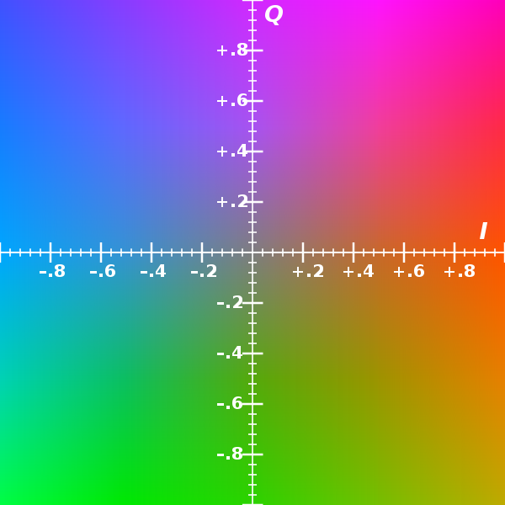
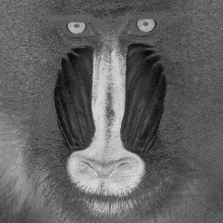
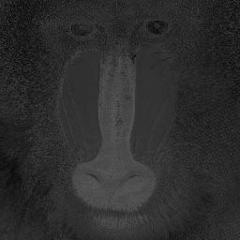

Color Models in Video
YIQ Color Model
YIQ is used in NTSC color TV broadcasting.
Y is the same with that in YUV
Chrominance I, Q are generated by U and V rotated by 33 degree: to better match actual human perceptual color sensitivities
$\left[\begin{matrix}Y \\ I \\ Q\end{matrix}\right]$=M $\left[\begin{matrix}R \\ G \\ B\end{matrix}\right]$, M is the transformation matrix.
Y
I
Q

Slide 35
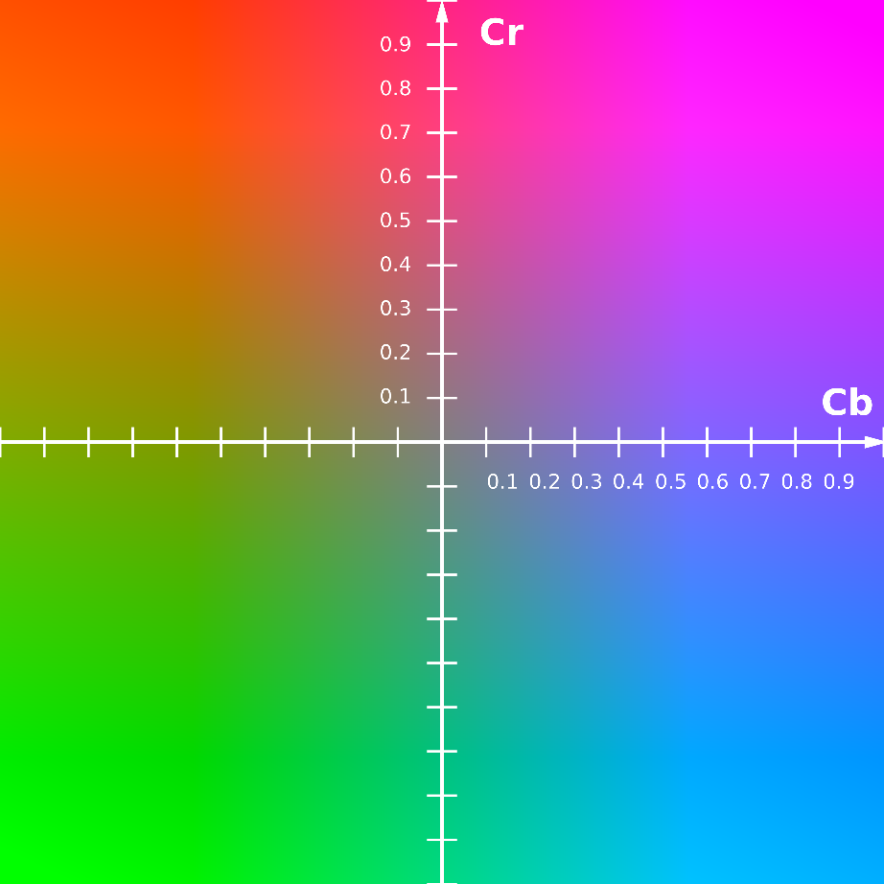
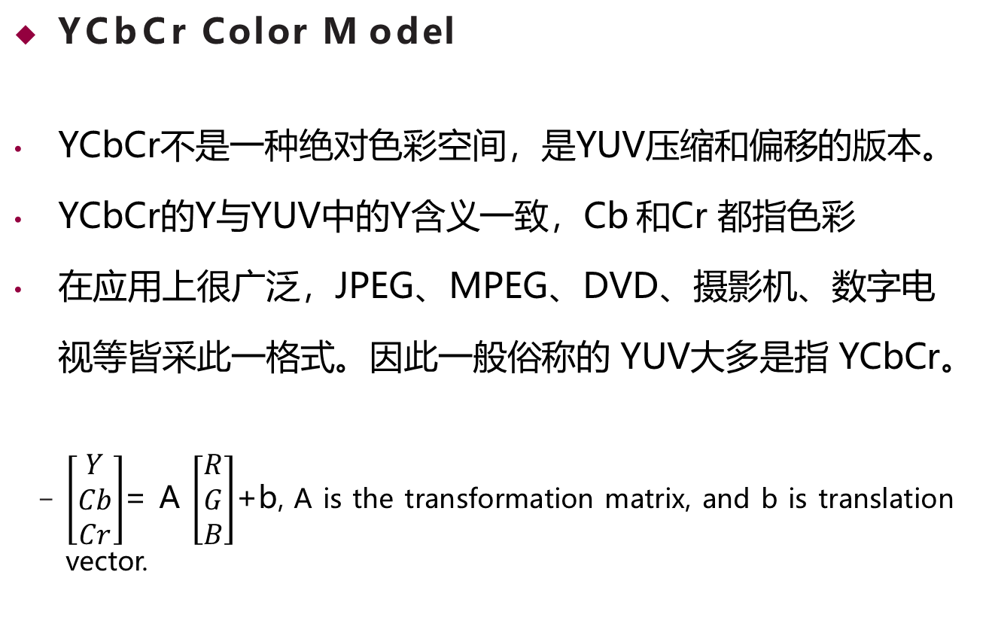
Color Models in Video
YCbCr Color Model
YCbCr不是一种绝对色彩空间，是YUV压缩和偏移的版本。
YCbCr的Y与YUV中的Y含义一致，Cb 和Cr 都指色彩
在应用上很广泛，JPEG、MPEG、DVD、摄影机、数字电视等皆采此一格式。因此一般俗称的 YUV大多是指 YCbCr。
$\left[\begin{matrix}Y \\ Cb \\ Cr\end{matrix}\right]$= A $\left[\begin{matrix}R \\ G \\ B\end{matrix}\right]$+b, A is the transformation matrix, and b is translation vector.

Slide 36
Outline of Lecture 03
Color Science
Light and Spectra
Human Vision
Image Formation
Color-Matching Functions
CIE Chromaticity Diagram
Out-of-Gamut Colors
Color Coordinate Schemes
Color Models in Image
Color Models in Video
Demo

Slide 37
Demo
Color space conversion run demoRGB.m
HSV = rgb2hsv(RGB)
labI=rgb2lab(RGB);
xyz = rgb2xyz(RGB);
RGB to YUV
Run mlhdlc_rgb2yuv_tb.m
Gamma correction
Run gammaCorrection.m

Slide 38
课后练习
1. 调研伽马矫正（Gamma correction）的作用、用途、原理
2. 调研相机为什么可以感应红绿蓝
相机工作原理
感光器件
色彩滤镜矩阵（Color Filter Array）

